Slide 1

Spreadsheet Project
Zomato Restaurants Analysis
Presented By Anchal Rani Barnowal

Slide 2
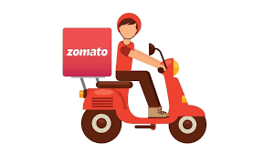

About Zomato
Zomato, founded in 2008, is a leading global platform for discovering and ordering food from restaurants. Initially focused on restaurant reviews and discovery, Zomato quickly expanded into online food delivery and table reservations, transforming the way people experience dining.
With a strong presence in over 20 countries, Zomato connects millions of customers to restaurants, offering seamless food delivery, exclusive memberships, and user-generated reviews. Through innovation and technology, Zomato continues to grow as a go-to platform for food lovers worldwide.
The name Zomato is derived from "Tomato" but with a "Z" to make it catchy, fun, and easy to remember.

Slide 3
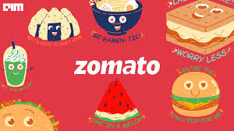
Data Cleansing and Processing
Extracted year, month, and date from the Datekey_Opening column to enable better granularity in analysis.
Removed blank rows where the "Cuisines" column had missing values to ensure data completeness.
Replaced zero values in the "Average Cost for Two" column with the average value of the respective city to maintain consistency.
Dropped the "Address" column as it was not relevant for analysis, reducing unnecessary clutter.
Removed duplicate rows to ensure data accuracy and avoid skewed insights.

Slide 4
Analytical Approach & Tools:
Data Cleansing: Leveraged Excel functions like FIND, RIGHT, LEFT, MID, TEXT, and DATE to clean and structure the data effectively.
Data Integration: Applied VLOOKUP to map country names and currencies accurately.
Descriptive Analysis: Created multiple pivot tables to identify regions with new restaurant openings, analyze key competitors and the identify price bucket range for restaurants.
Dynamic Visualization: Designed dynamic charts and dashboards to present insights interactively.
Feature Engineering: Added new columns for enhanced analysis and created a worksheet to standardize all currencies into USD.
Insights Extraction: Used conditional formatting and filters to highlight key insights, such as country and restaurant-specific trends.

Slide 5
Restaurant Openings Over the Years
Steady Openings: The number of restaurants opening each year has remained relatively consistent, ranging between 1,022 and 1,102 across all years.
Peak Year: The highest number of restaurant openings occurred in 2018 with 1,102 restaurants, indicating strong growth in that year.
Lowest Year: The lowest number of openings was in 2012, with 1,022 restaurants, possibly due to economic or industry-specific factors.
Recovery After Dips: While openings dipped slightly in 2012 and 2015, they steadily recovered in subsequent years, showing resilience in the industry.
Gradual Growth: There is a slight upward trend from 2015 to 2018, reflecting an increasing demand for restaurants or better market opportunities in recent years.

Slide 6
Customer Engagement Analysis by Country
Indonesia leads significantly with an average of 772 votes, indicating strong customer engagement or popularity of restaurants in this region.
United Arab Emirates (494), Turkey (431), Philippines (407), and South Africa (315) also show high average votes, reflecting a strong customer base or loyalty.
Regions with lower votes like Brazil and Singapore may offer opportunities for growth or need better marketing strategies to increase customer engagement.

Slide 7
Restaurant Market Distribution by Country
India's Dominance in the Global Market: With 8652 restaurants, India leads by a significant margin, accounting for the majority of the global restaurant count.
Key Markets with Strong Restaurant Presence: The United States (425), United Kingdom (80), and Brazil (60) represent some of the top countries with notable restaurant networks, indicating diverse market engagement.
Potential for Growth in Low-Density Markets: Canada (with only 4 restaurants) and others with lower restaurant counts may represent untapped markets for future development.
Global Restaurant Trends: The total of 9542 restaurants worldwide highlights a highly concentrated market, with a few key players driving the restaurant industry.

Slide 8
Opportunities in Low-Competition Restaurant Markets
Countries with shorter bars in the previous chart, such as Canada, Qatar, Sri Lanka, Singapore and Indonesia, indicate a lower number of restaurants. These countries represent areas with relatively lesser competition.
Canada has several cities like Chatham-Kent, Consort, Vineland Station and Yorkton with only 1 restaurant each. These cities have low competition, making them ideal for opening new restaurants.
Qatar, Singapore, Sri Lanka have slightly higher competition with 20 restaurants in their capital cities (Doha, Singapore, and Colombo). And Indonesia with 21 restaurants across its cities. However, these cities may still be suitable for opening new restaurants depending on their growth potential and the type of cuisine being offered.

Slide 9
Restaurant Count and Average Rating by Cuisine
Conclusion: The choice of cuisines impacts restaurant ratings:
Cuisines like Italian (3.73) and Bakery, Desserts, Fast Food (3.40) outperform the overall average (2.58), indicating a strong correlation between cuisine type and customer satisfaction.
Poor-performing cuisines like North Indian (2.15) and Biryani (1.97) negatively affect feedback despite their popularity or high presence.
By focusing on high-performing cuisines, newer restaurants can enhance customer satisfaction and improve ratings.

Slide 10
Online Delivery Impact on Restaurant Ratings
Higher Rating with Online Delivery: Restaurants offering online delivery have a higher average rating (3.29) compared to those that do not offer it (2.75).
Larger Proportion of Restaurants without Online Delivery: The majority of restaurants (74.31%) do not provide online delivery, yet their average rating is lower.
Recommendations: Given the higher average ratings for restaurants with online delivery, it would be advisable to consider incorporating online delivery in restaurant services to potentially improve customer satisfaction and ratings.

Slide 11
Price Bucket List by Restaurant Counts
It is observed that the majority of restaurants fall within the lower to mid-range categories (between 0-1000). The highest price range (10000-45000) has a significantly smaller number of restaurants.
Recommendations:
Since the majority of restaurants fall within the 0-1000 price range, businesses should prioritize offerings in this segment, focusing on value for money and catering to a wider customer base.
The 300-600 price range, with 3615 restaurants, is the largest category. This indicates a substantial demand for restaurants offering mid-tier pricing. Restaurants can consider expanding their menu options or introducing more varied pricing models within this range to attract more customers.

Slide 12
Online Delivery Trends and Insights
Majority of Restaurants Do Not Offer Online Delivery: 74.31% of restaurants don’t provide online delivery, limiting options for customers who prefer it.
Online Delivery Adoption is Limited: Just 25.69% of restaurants have online delivery, serving a smaller group of customers who want convenience.
Potential for Growth in Online Delivery: Adding online delivery could help restaurants reach more customers and grow their business.

Slide 13
Weekday vs. Weekend Spending on Dining
Customers spend significantly more on dining during weekdays, with a total of ₹5,783K compared to ₹2,302K on weekends.
Recommendations:
Introduce Weekend Promotions: Boosts customer footfall and increases revenue on weekends by encouraging more dining out through attractive offers like discounts or combo deals.
Expand Takeaway and Delivery Options for Weekends: Captures customers who prefer staying at home on weekends, driving additional revenue through convenient meal options.

Slide 14
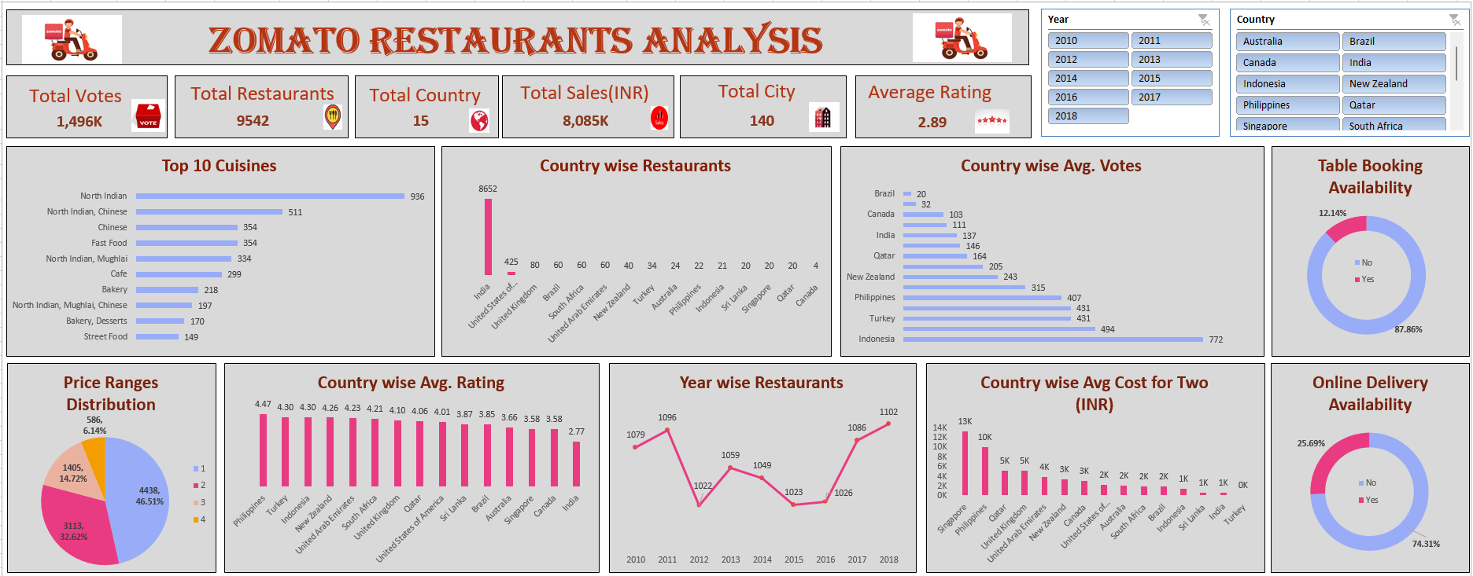
Dashboard and Visualization:

Slide 15

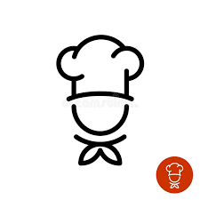

Conclusion
Opportunities in Low-Competition Markets : Countries like Canada, Qatar, Sri Lanka, and Singapore have fewer restaurants, indicating lower competition. Expanding into these markets could help Zomato establish a strong presence with less resistance from competitors.
Focus on High-Performing Cuisines : Identifying and offering cuisines with higher demand and satisfaction can attract more customers, improve overall ratings, and drive loyalty. A data-driven approach to understanding popular cuisines will ensure success in diverse markets.
Incorporate Online Delivery Services : Restaurants with online delivery options consistently achieve higher ratings. Adding this feature will not only enhance customer satisfaction but also increase accessibility, helping Zomato restaurants reach a larger audience and boost revenue.
Our Zomato Restaurant Analysis provides a strategic roadmap for expansion.
By targeting low-competition markets, focusing on high-performing cuisines, and leveraging the benefits of online delivery.
Zomato can optimize its restaurant openings and customer reach. These strategies, driven by data insights, ensure a balanced approach that addresses customer preferences, market gaps, and long-term business growth.

Slide 16

Thank You

